Slide 1
VOTE APPLICATION USING DJANGO FRAMEWORK
NAAN MUDHALVAN POLLING PROJECT USING DJANGO
DEVELOPED BY
K. SNEHA
III-YEAR CSE
RVCE

Slide 2
Pre-requisite: Knowledge of Python and basics of Django Framework. Python should be installed in the system. Visual studio code or any code editor to work on the application. Technologies used in the project: Django framework and SQLite database which comes by default with Django. Modules used in this project: 1.Htmltemplates 2.Pollingproject 3.polls 4.Pollswebsite 5.Admin Panel Implementation of the Project Creating Project Step-1: Create an empty folder pollster_project in your directory. Step-2: Now switch to your folder and create a virtual environment in this folder using the following command. pip install pipenv pipenv shell Step-3: A Pipfile will be created in your folder from the above step. Now install Django in your folder using the following command. pipenv install django Step-4: Now we need to establish the Django project. Run the following command in your folder and initiate a Django project. django-admin startproject pollster A New Folder with name pollster will be created. Switch to the pollster folder using the following command. cd pollster The folder structure will look something like this. Here you can start the server using the following command and check if the application running or not using your http://127.0.0.1:8000/ in your browser. python manage.py runserver Step-5: Create an app ‘polls‘ using the following command python manage.py startapp polls

Slide 3
Implementation of the Project
Creating Project
Step-1: Create an empty folder Pollingproject in your directory.
Step-2: Now switch to your folder and create a virtual environment in this folder using the following command.
pip install pipenv pipenv shell
Step-3: A Pipfile will be created in your folder from the above step. Now install Django in your folder using the following command.
pipenv install django
Step-4: Now we need to establish the Django project. Run the following command in your folder and initiate a Django project.
Step-5: Create an app ‘polls‘ using the following command
python manage.py startapp polls

Slide 4
Create Models
Step-1: In your models.py file write the code to create two tables in your database. One is ‘Question‘ and the other one is ‘Choice‘. ‘Question’ will have two fields of ‘question_text’ and a ‘pub_date’. Choice has three fields: ‘question’, ‘choice_text’, and ‘votes’. Each Choice is associated with a Question.
Step-2: Go to the settings.py file and in the list, INSTALLED_APPS write the code to include the app in our project. This will refer to the polls apps.py -PollsConfig class.
Step-3: We have made changes in our database and created some tables but in order to reflect these changes we need to create migration here and then Django application will stores changes to our models. Run the following command given below to create migrations.
python manage.py makemigrations polls
Inside polls-migrations a file 0001_initial.py will be created where you can find the database tables which we have created in our models.py file. Now to insert all the tables in our database run the command given below…
python manage.py migrate

Slide 5
CODE:
from django.db import models # Create your models here. class Question(models.Model): question_text = models.CharField(max_length = 200) pub_date = models.DateTimeField('date published')
def __str__(self): return self.question_text
class Choice(models.Model): question = models.ForeignKey(Question, on_delete = models.CASCADE) choice_text = models.CharField(max_length = 200) votes = models.IntegerField(default = 0) def __str__(self): return self.choice_text

Slide 6
Create an Admin User
Step-1: Run the command given below to create a user who can login to the admin site.
python manage.py createsuperuser It will prompt username which we need to enter then will prompt an email address which again we need to enter then the final step is to enter the password.
Now we can run the server using the same command python manage.py runserver and we can check our admin panel browsing the URL http://127.0.0.1:8000/admin .
Step-2: In the admin.py file we will write the code to map each question with choices to select. Also, we will write the code to change the site header, site title, and index_title. Once this is done we can add questions and choices for the question from the admin panel.

Slide 7
Admin coding:
from django.contrib import admin
# Register your models here.
from .models import Question, Choice
# admin.site.register(Question)
# admin.site.register(Choice)
admin.site.site_header = "Pollster Admin"
admin.site.site_title = "Pollster Admin Area"
admin.site.index_title = "Welcome to the Pollster Admin Area“
class ChoiceInLine(admin.TabularInline):
model = Choice
extra = 3
class QuestionAdmin(admin.ModelAdmin):
fieldsets = [(None, {'fields': ['question_text']}), ('Date Information', {
'fields': ['pub_date'], 'classes': ['collapse']}), ]
inlines = [ChoiceInLine]
admin.site.register(Question, QuestionAdmin

Slide 8
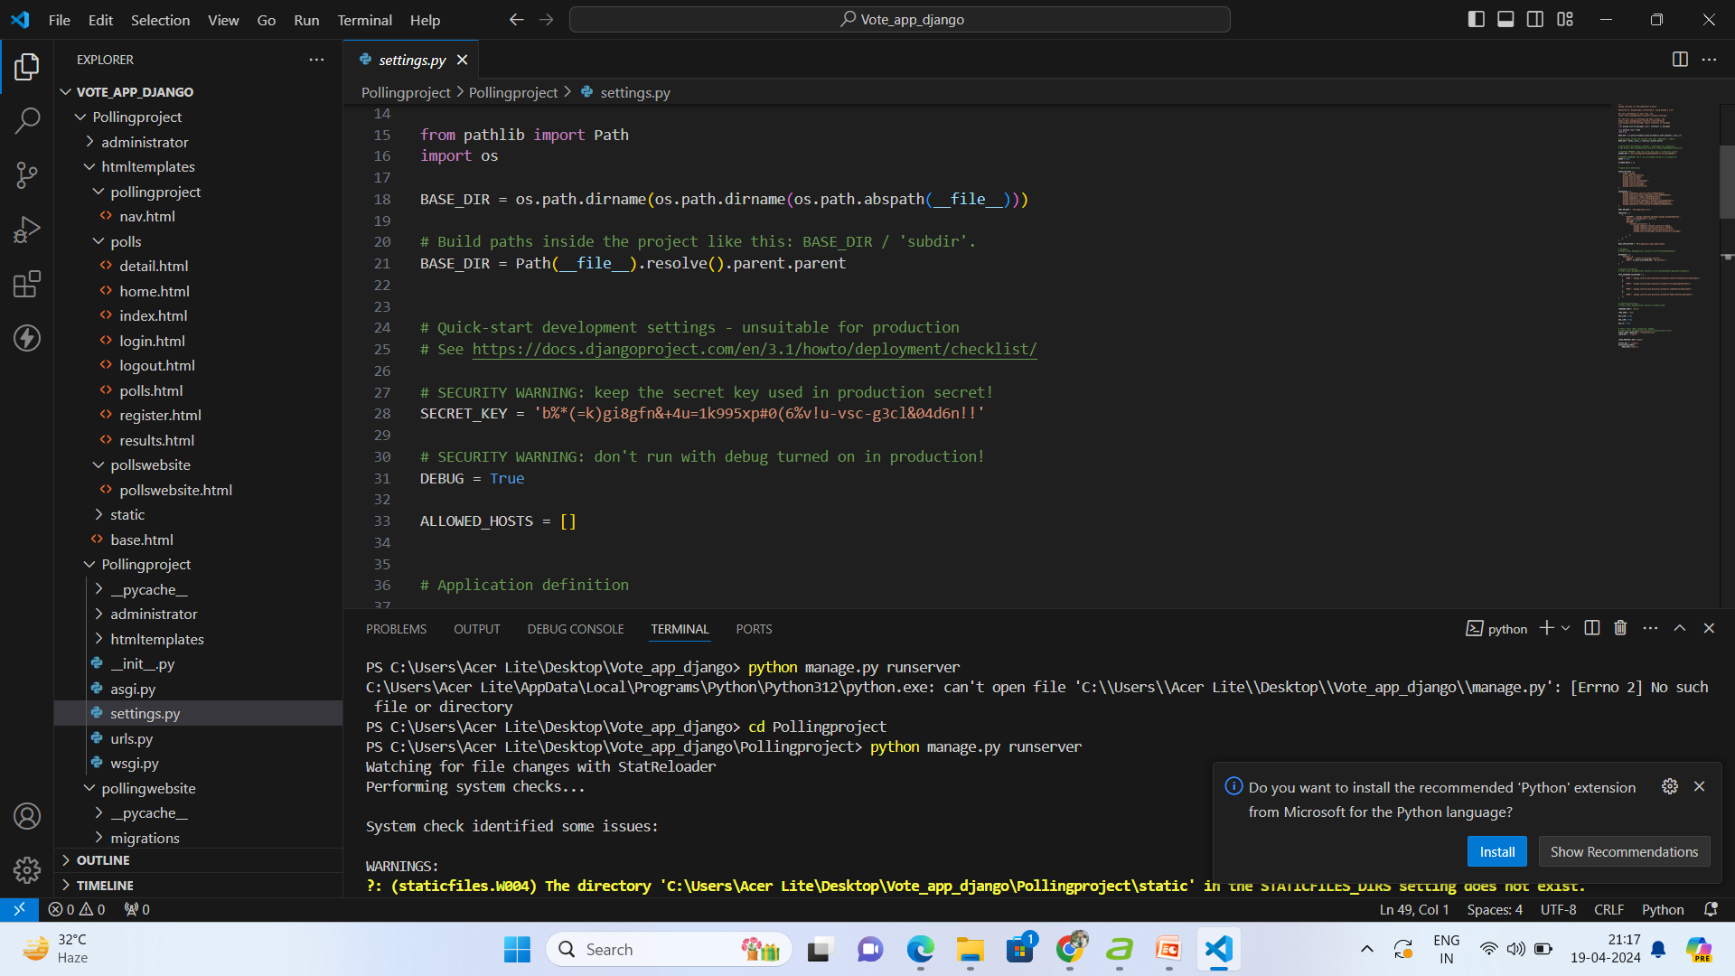
Create Views
Now we will create the view of our application that will fetch the data from our database and will render the data in the ‘template‘ of our application to display it to the user.
Step-1 Open views.py file and write the code.
Step-2: Create a file urls.py inside the pollster-polls folder to define the routing for all the methods we have implemented in views.py file.

Slide 9
from django.template import loader
from django.http import Http404, HttpResponse, HttpResponseRedirect
from django.shortcuts import get_object_or_404, render
from django.urls import reverse
from .models import Question, Choice
from django.shortcuts import redirect
from django.contrib.auth.forms import UserCreationForm
from django.contrib.auth import authenticate, login, logout
Views.py
from django.template import loader
from django.http import HttpResponse, HttpResponseRedirect
from django.shortcuts import get_object_or_404, render
from django.urls import reverse
from .models import Question, Choice
# Get questions and display them
def index(request):
latest_question_list = Question.objects.order_by('-pub_date')[:5]
context = {'latest_question_list': latest_question_list}
return render(request, 'polls / index.html', context)
# Show specific question and choices
def detail(request, question_id):
try:
question = Question.objects.get(pk = question_id)
except Question.DoesNotExist:
raise Http404("Question does not exist")
return render(request, 'polls / detail.html', {'question': question})
# Get question and display results
def results(request, question_id):
question = get_object_or_404(Question, pk = question_id)
return render(request, 'polls / results.html', {'question': question})
# Vote for a question choice
def vote(request, question_id):
# print(request.POST['choice'])
question = get_object_or_404(Question, pk = question_id)

Slide 10
Create Templates
Step-1: Follow the steps given below to create the front layout of the page.
• Create a folder ‘templates‘ in top-level pollster folder i.e. pollster-templates.
• Create ‘base.html‘ file inside the template folder. We will define the head, body and navigation bar of our application in this file.
• In the ‘templates’ folder create another folder ‘polls‘. In ‘polls’ folder create three files ‘index.html‘, ‘results.html‘ and ‘detail.html‘.
Step-2: By default Django will search the ‘template’ inside the ‘polls’ app but we have created a global ‘template’ folder which is outside the polls app.
Step-3: Open index.html file and write the code given below. This file will display the list of questions which are stored in our database. Also, two buttons will be displayed to the user. One for the voting and the other one is to check the results.

Slide 11
INSTALLED APPS: Go to the settings.py file and in the list, INSTALLED_APPS write down the code below to include the app in our project. This will refer to the polls -> apps.py -> PollsConfig class . CODING:settings.py
INSTALLED_APPS = [ 'polls.apps.PollsConfig', 'django.contrib.admin', 'django.contrib.auth', 'django.contrib.contenttypes', 'django.contrib.sessions', 'django.contrib.messages', 'django.contrib.staticfiles', ]

Slide 12
URL.PY Create a file urls.py inside the pollster->polls folder to define the routing for all the methods we have implemented in views.py file (don’t get confused with the file inside the polls->polls->urls.py file). Below is the code of urls.py file…
Urls.py Coding:
from django.urls import path
from . import views
app_name = 'polls'
urlpatterns = [
path('', views.index, name ='index'),
path('<int:question_id>/', views.detail, name ='detail'),
path('<int:question_id>/results/', views.results, name ='results'),
path('<int:question_id>/vote/', views.vote, name ='vote'),
]

Slide 13
Create polls
Step-1 Switch to the top-level pollster folder and run the command given below to create an app ‘pages‘.
python manage.py startapp polls
Step-2 Open ‘views.py‘ inside ‘pages’ folder i.e. pages-views.py. Write the code to visit on landing page.
Step-3 Create urls.py file inside the ‘pages’ folder i.e. pages-urls.py. Write the code to define the routing of pages-index.html file .
Step-4 Create a folder ‘polls‘ inside ‘template’ folder. Now inside ‘pages’ folder create a file index.html. Write down the code to display the landing page to the users.

Slide 14
Create routing inside the main urls.py file of the application
We have created two apps in our application ‘polls‘ and ‘pollingproject‘. We need to define the routing of these two apps inside the main urls.py file which is pollster-pollster-urls.py file. So open the main urls.py file inside the pollster folder and write the code to define the routing of these two apps .

Slide 15
STEPS INVOLVED IN PROJECT:
1.Python should be installed: Download and install the latest version of Python from the official website, following the installation instructions for your operating system. 2. Install pip: Download the get-pip.py script and run python get-pip.py to install pip. 3. Create a virtual environment: Run python -m venv myenv to create a new virtual environment named ‘myenv’. 4. Activate the virtual environment: Run source myenv/bin/activate on Linux/Mac or myenv\Scripts\activate on Windows to activate the virtual environment.
5. Install Django: Run pip install django to install the latest stable version of Django. 6. Verify installation: Run python -m django –version to verify that Django is installed correctly. 7. Create a new Django project: Run django-admin startproject project to create a new Django project named ‘ project’.
8. Start the development server: Run python manage.py runserver to start the development server. That’s it! A working installation of Django should now be in place, and you should be ready to start building y your web Application

Slide 16
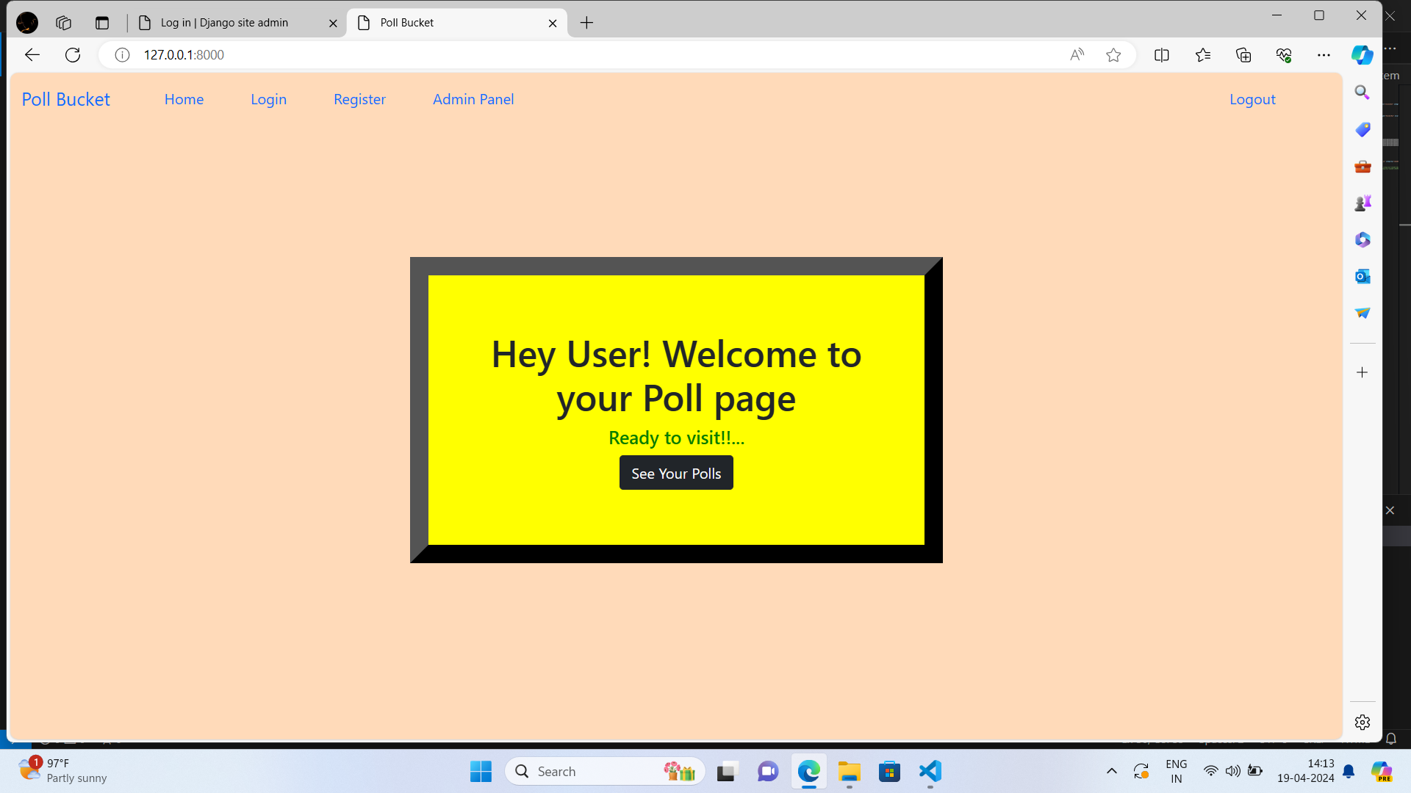
DEVELOPMENT PART:
Here I have developed the nav bar to route to different pages.Where there are home , login, register and logout pages.
Each page routes to the respective pages.
Also developed the admin panel to route to admin page
I have developed the admin page to add questions.
home(request):
This view renders the main page (votingpage.html) after the user has successfully logged in.
It shows the polls page.

Slide 17
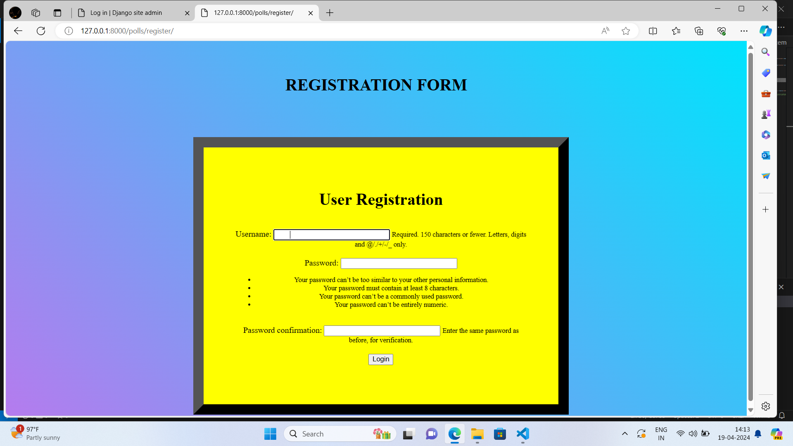
1 register(request):
This view renders the registration page (registration.html).
This view handles the registration process when the registration form is submitted.
It first checks if the passwords provided by the user match.
If the passwords match, a new User object is created with the provided username and email.
The password is set and encrypted using the set_password method.
The new user is saved to the database, and the user is redirected to the login page (index).

Slide 18
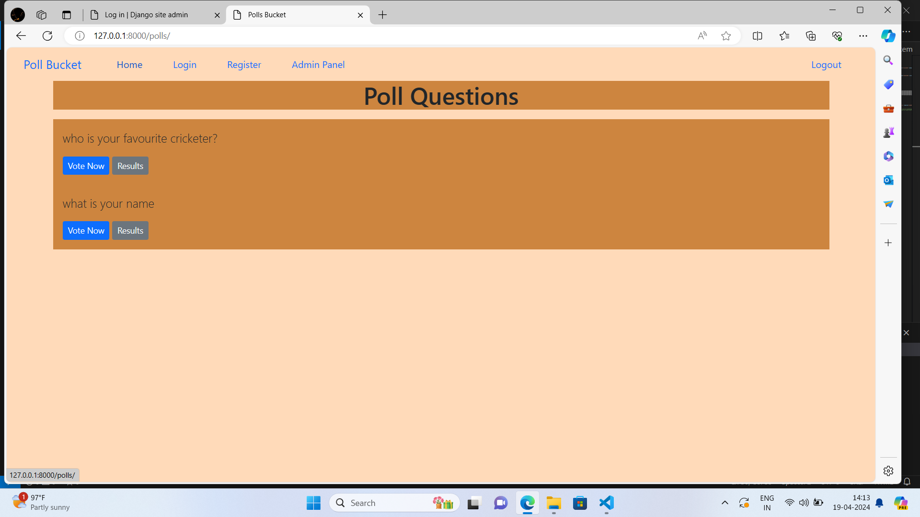
Voting(request, pk):
This view handles the process of voting for a specific question.
It first retrieves the authenticated user and the question (specified by its primary key pk) using get_object_or_404.
It checks if the user has already voted for the question by searching for an existing record in the Voted model.
If the user has not voted for the question, the vote count for the question is incremented, and the vote is saved.
A new record is created in the Voted model to indicate that the user has voted for that question.
The user is then redirected to the “show” page.

Slide 19
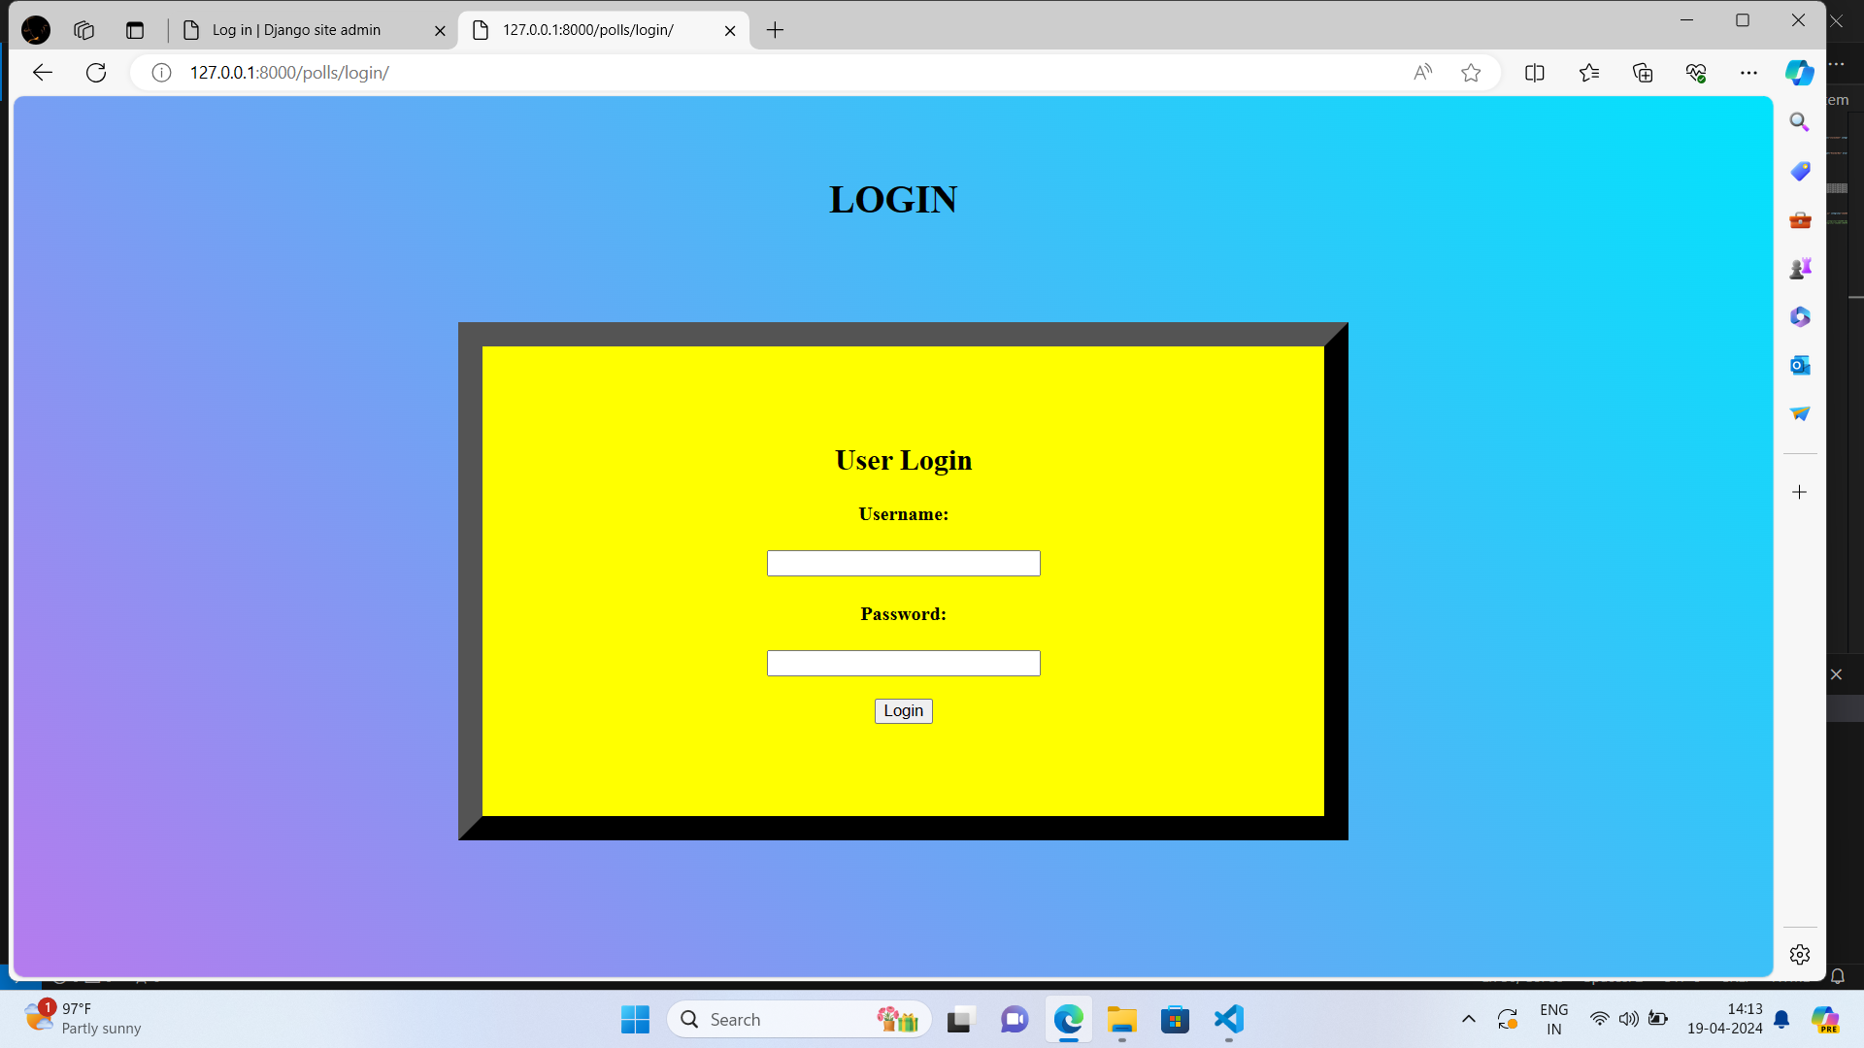
4. Loginview(request):
This view handles the login process when the login form is submitted.
It retrieves the username and password entered by the user.
The authenticate function is used to verify the credentials. If the authentication is successful, the user is logged in using the login function, and they are redirected to the “show” page.
If the authentication fails, an “invalid credentials” message is displayed

Slide 20
LOGOUT:
This view handles the logout process.
The logout function is called to log out the user.
The user is then redirected to the login page (index).
These views, along with the corresponding URL patterns defined in the urlpatterns list, form the routing and logic for the online voting system. When logout it redirects to Homepage.

Slide 21
USER PANEL:

Slide 22
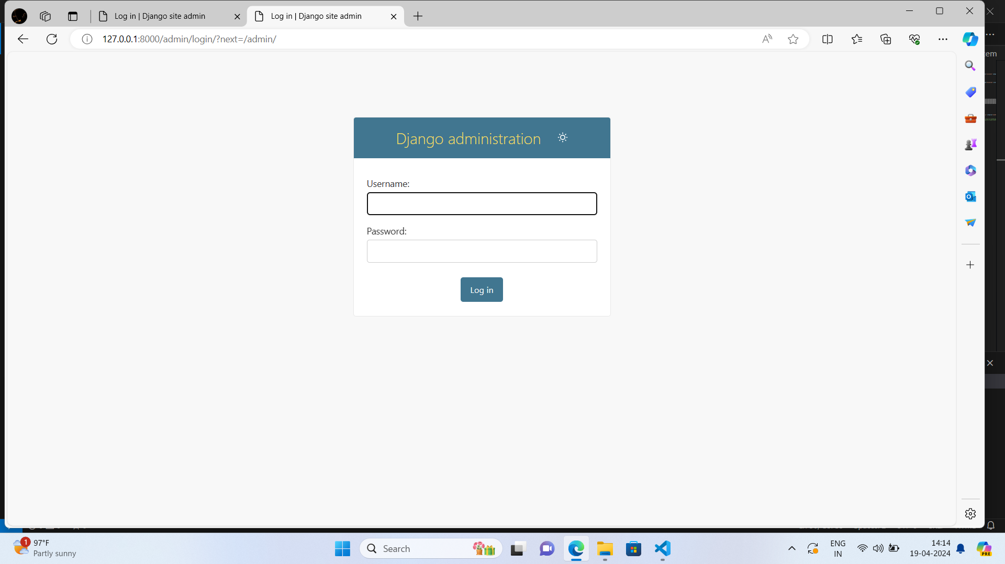
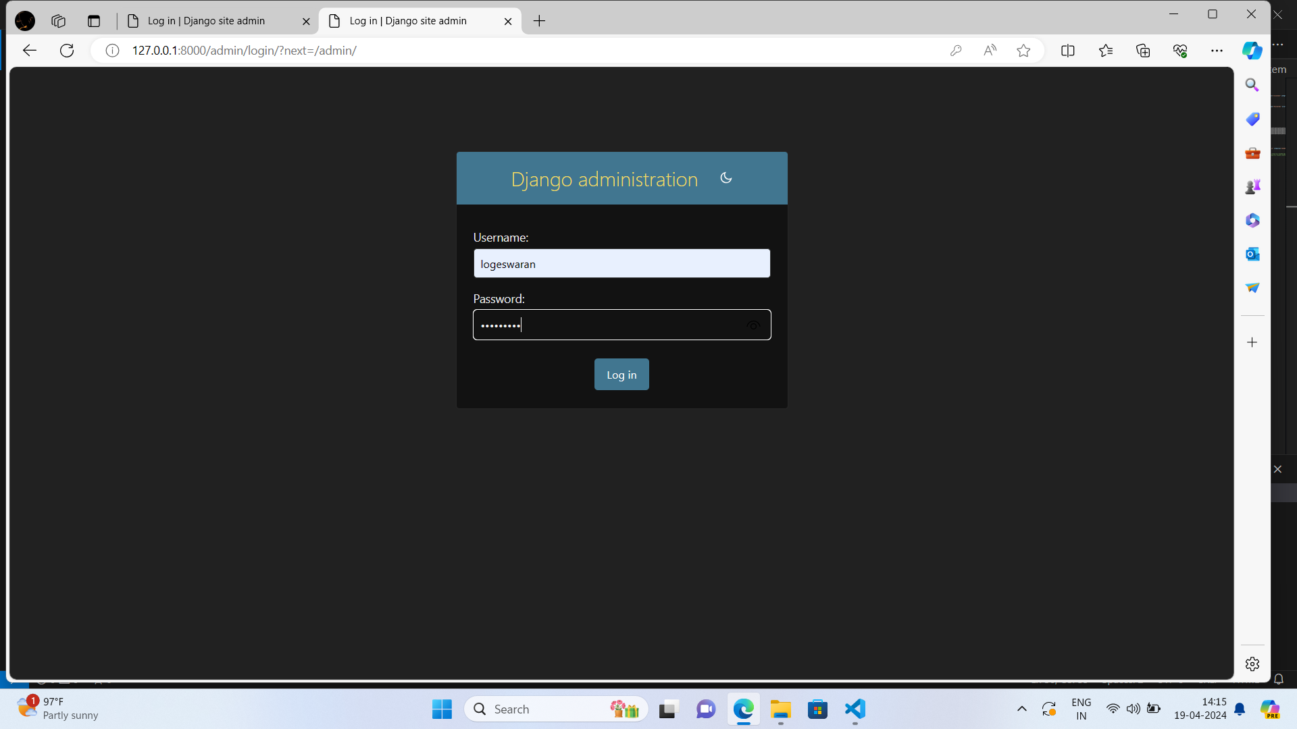
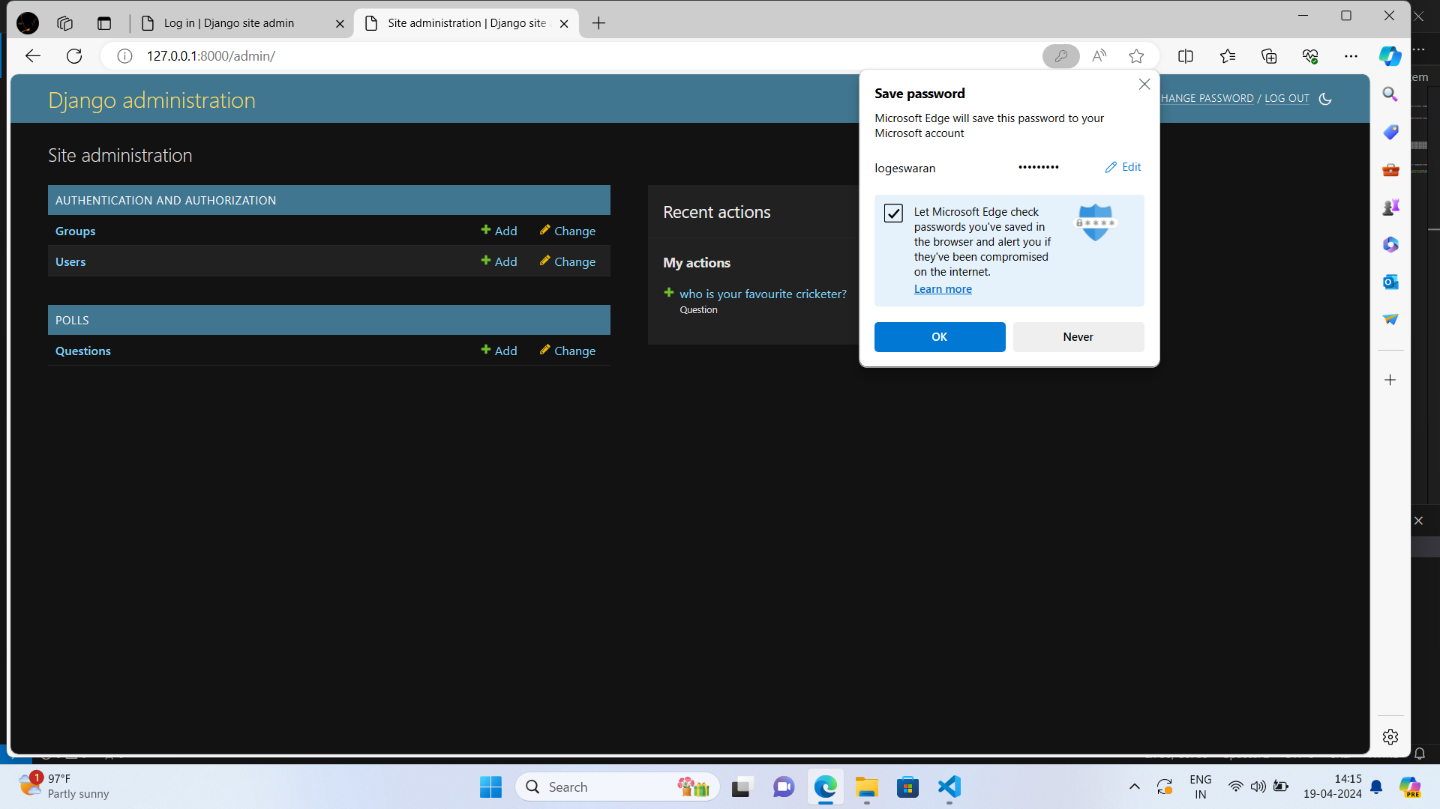
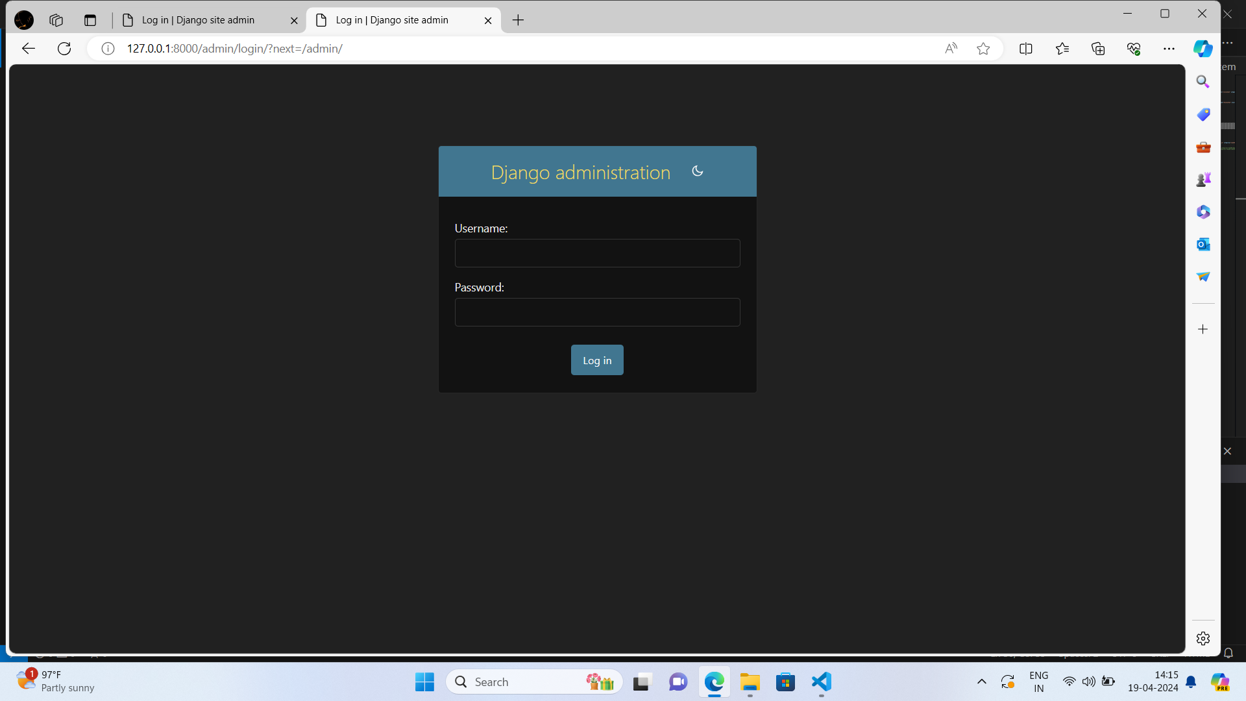
ADMIN PANEL:

Slide 23
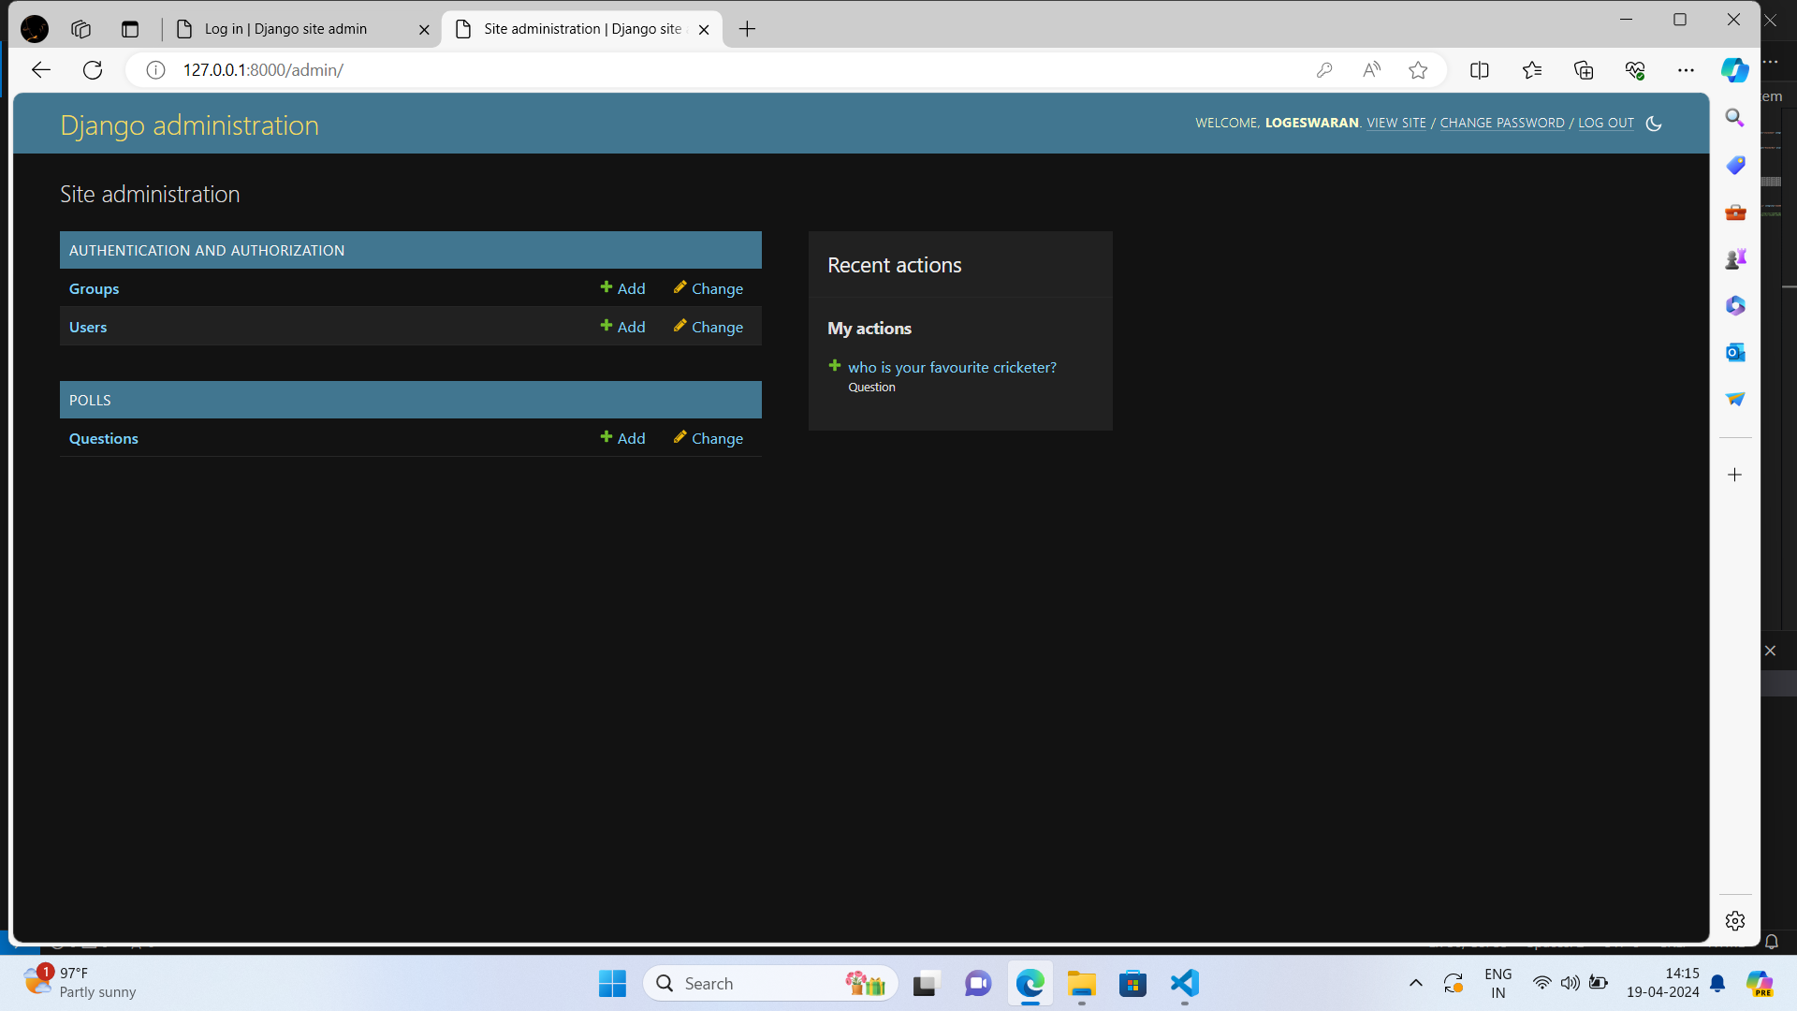
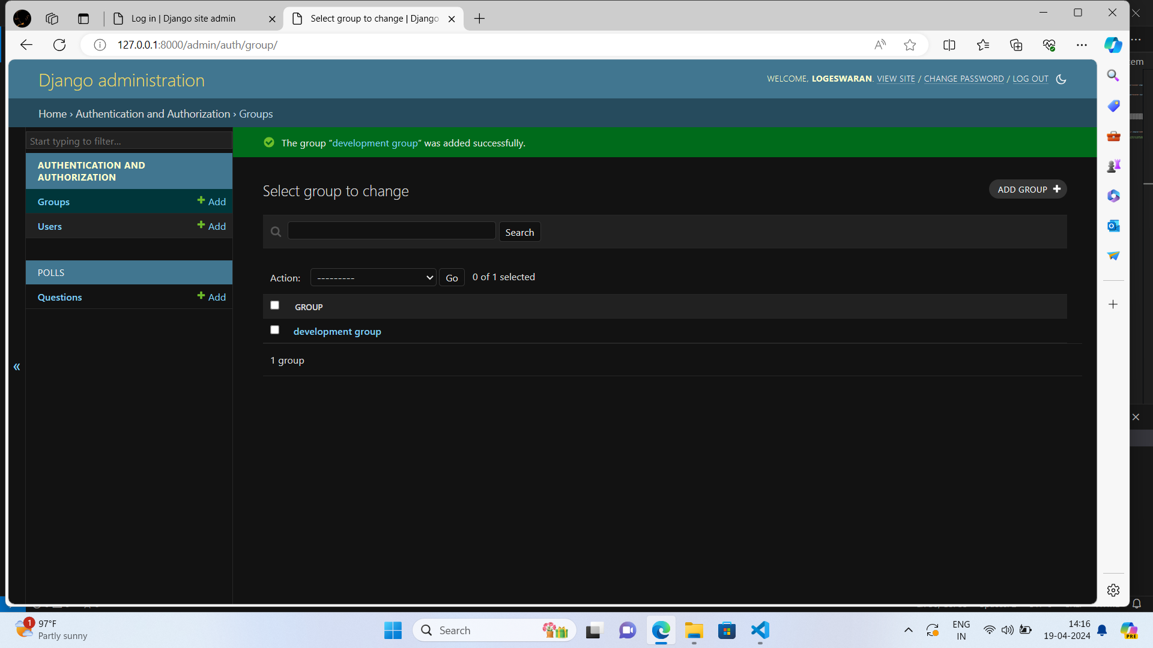
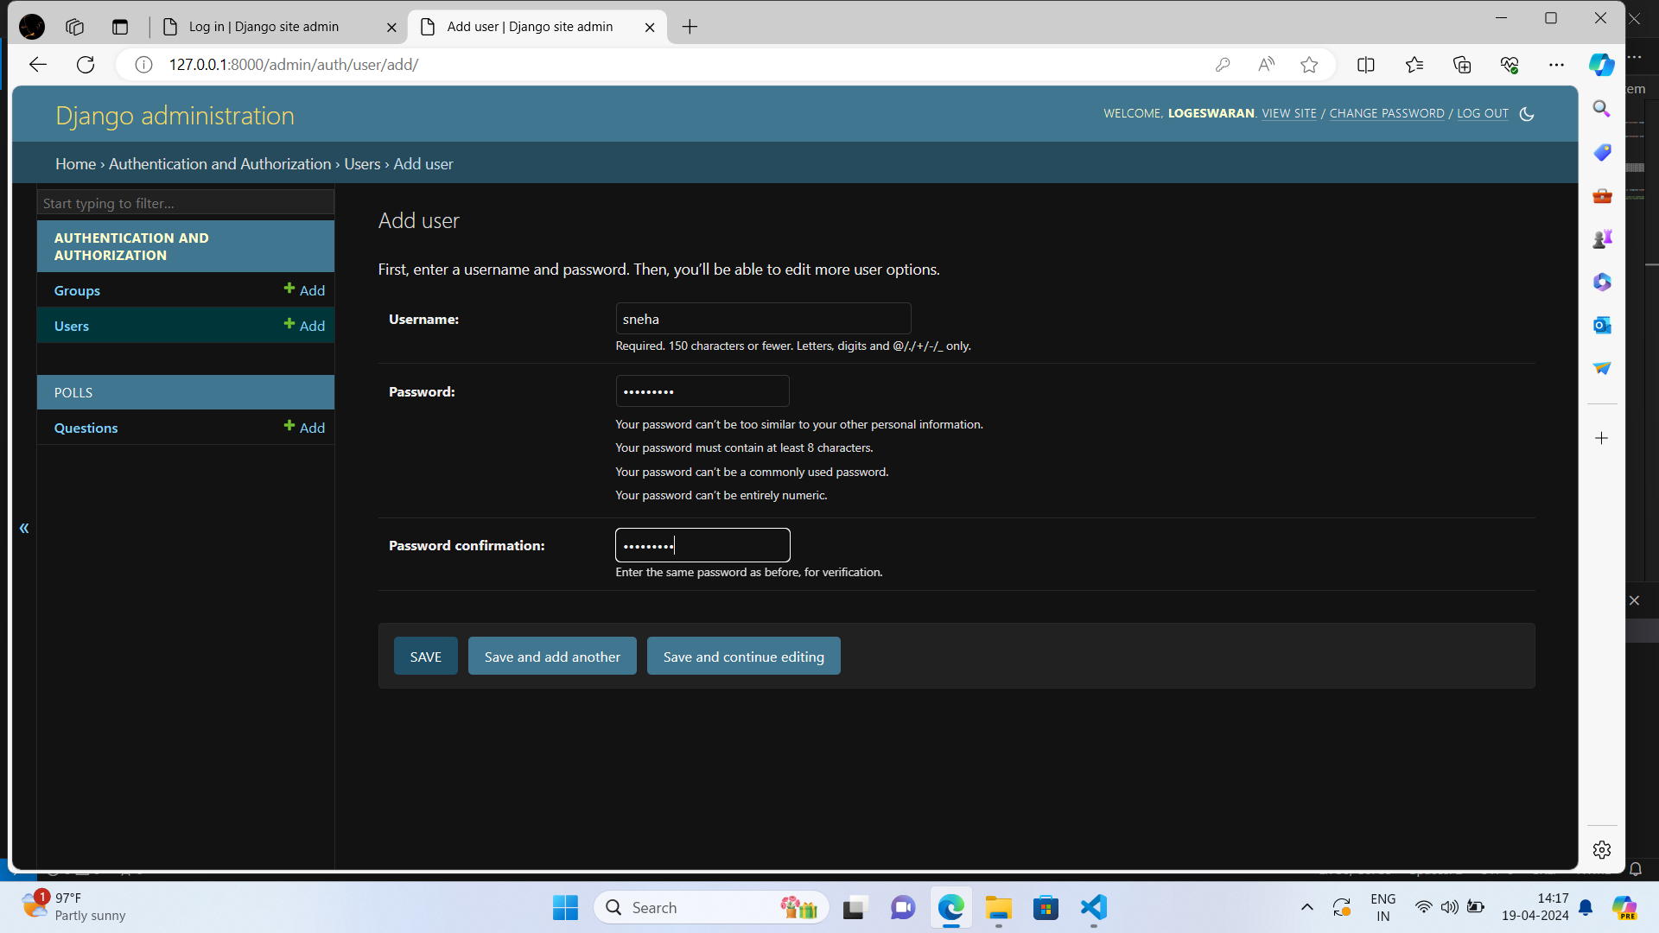
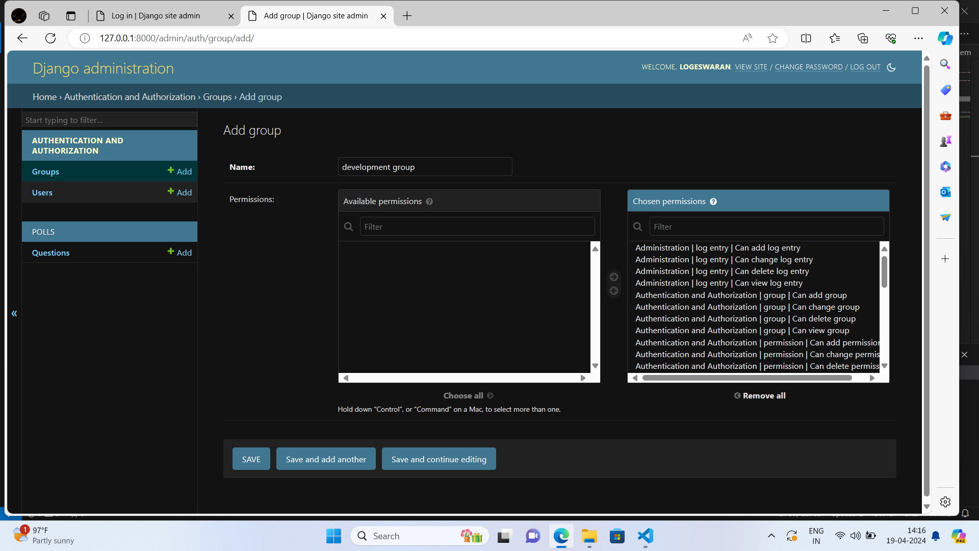
ADMIN PANEL:

Slide 24
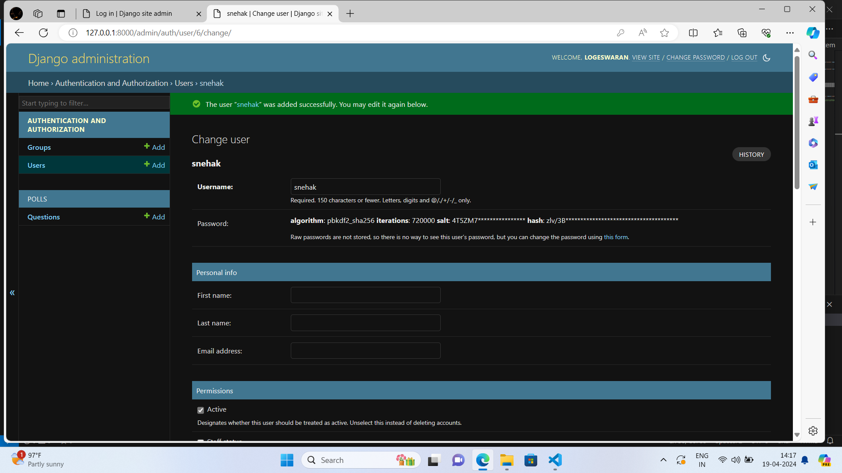
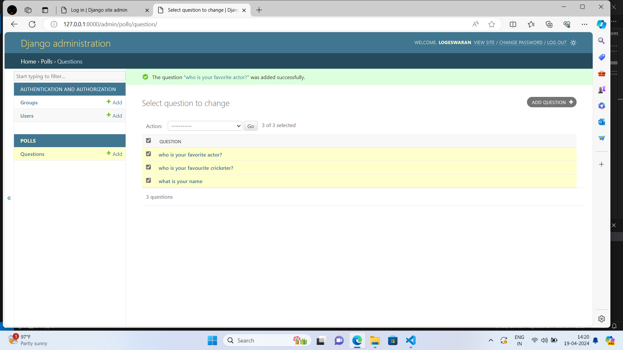
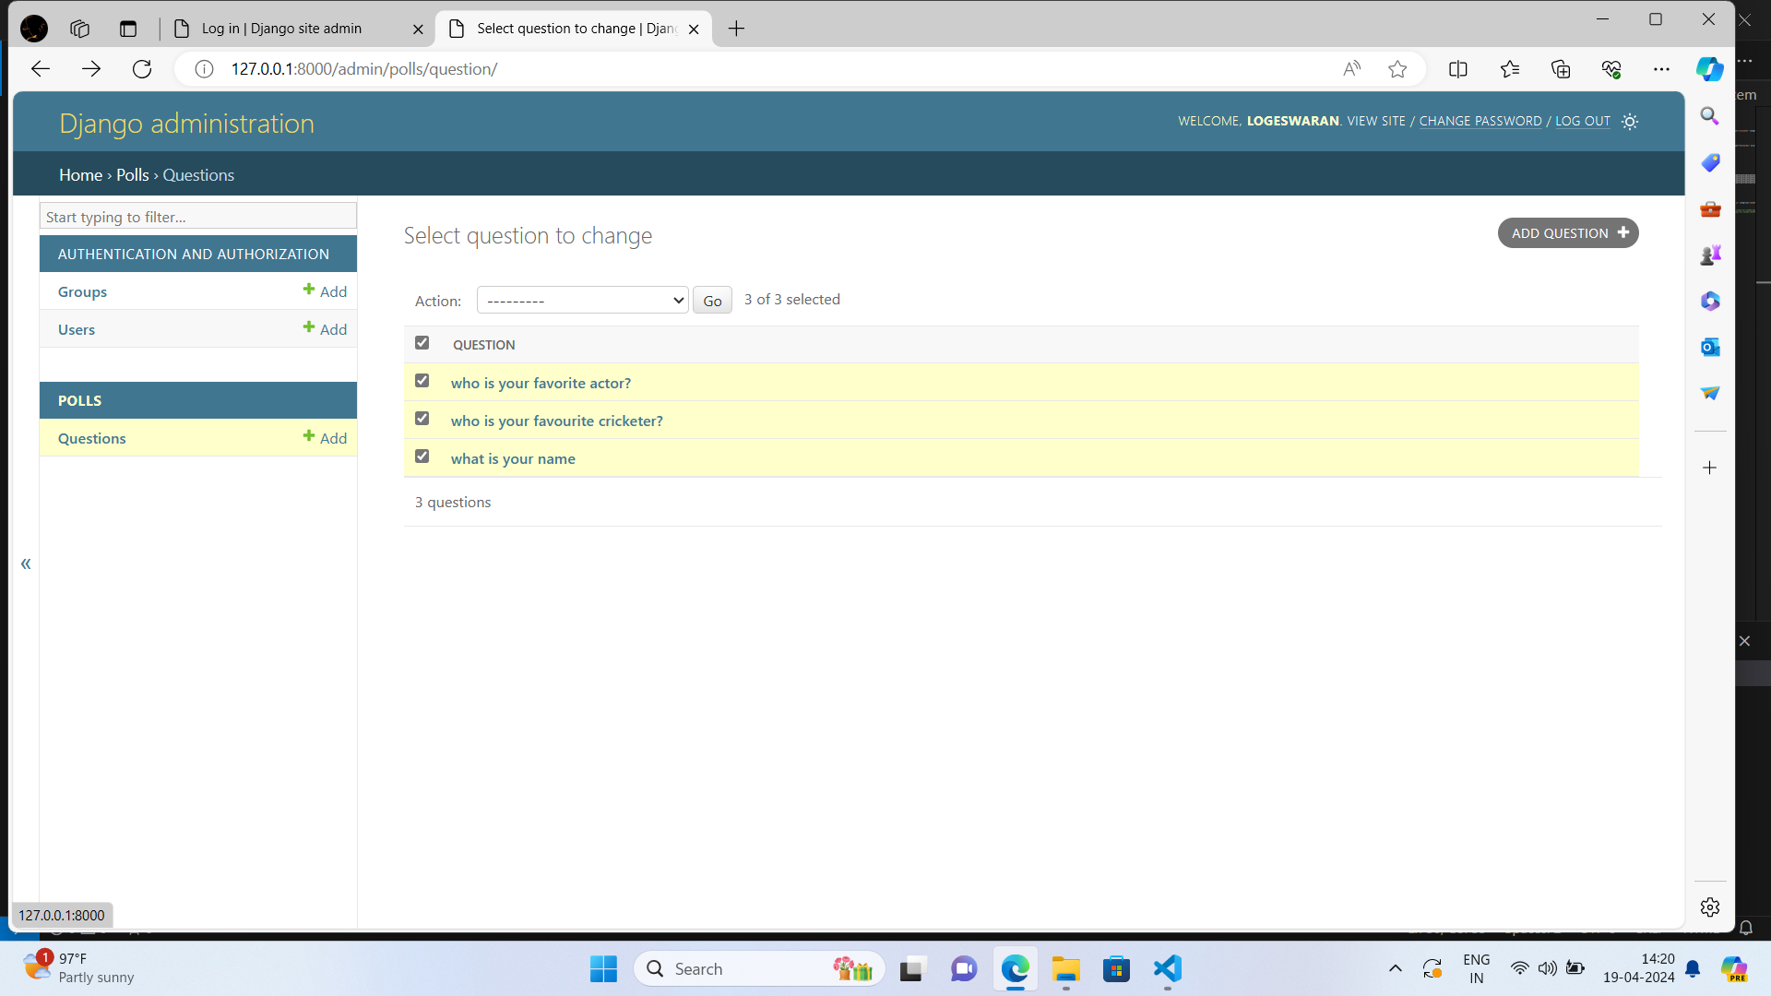
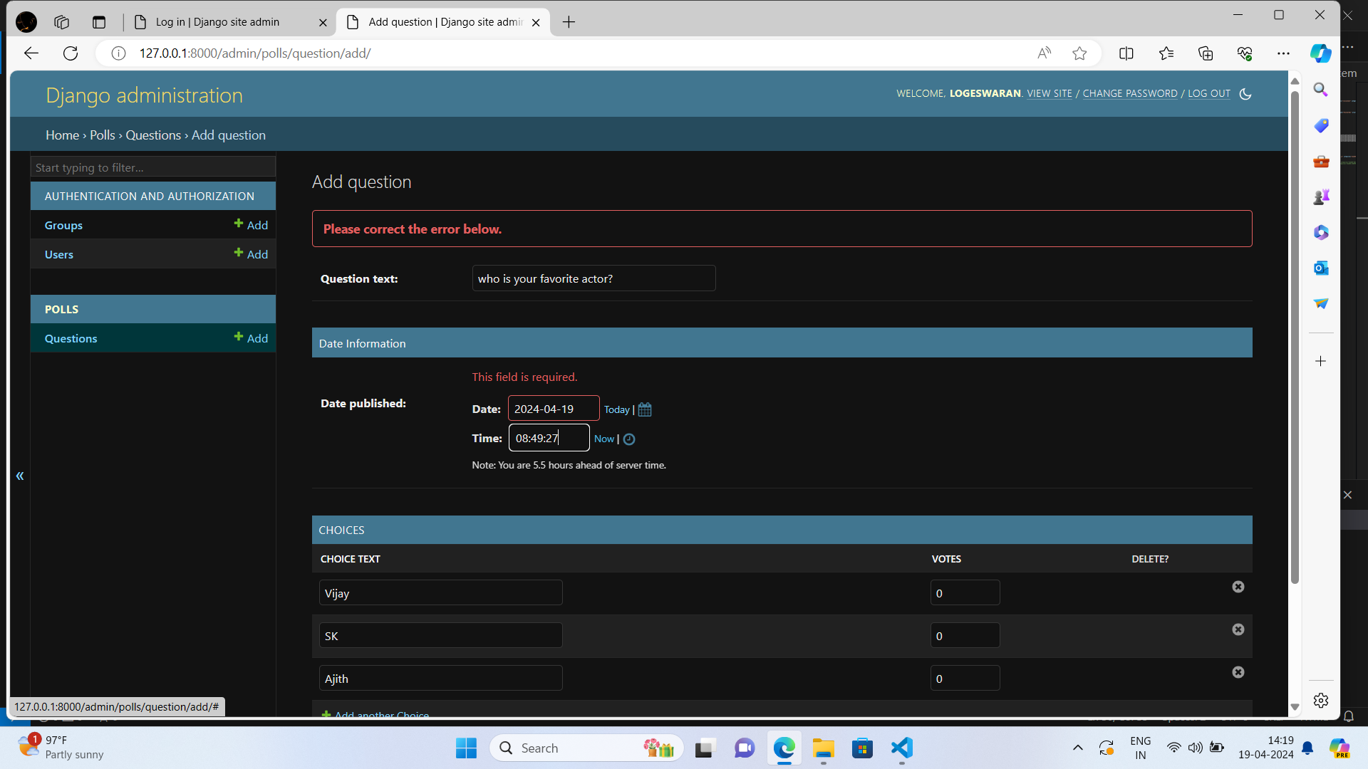
ADMIN PANEL:

Slide 25
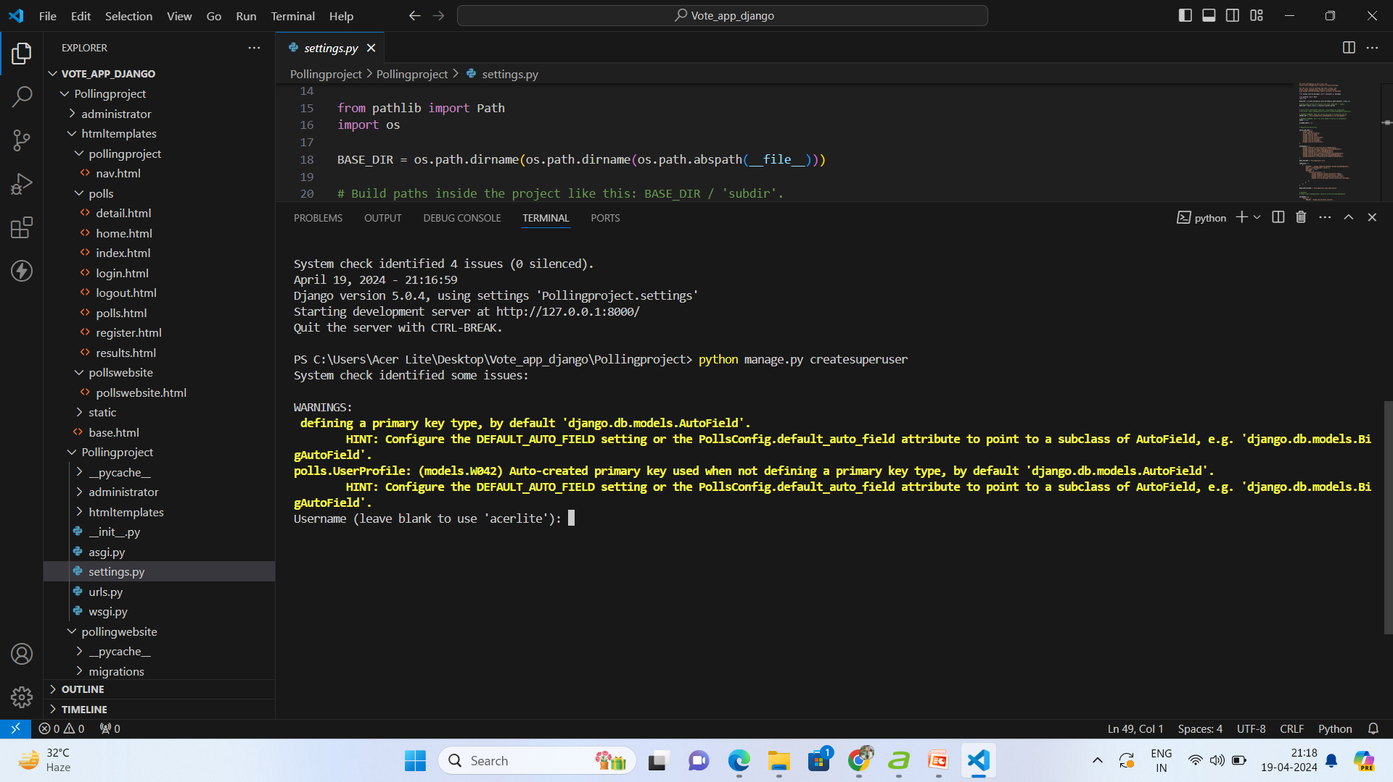
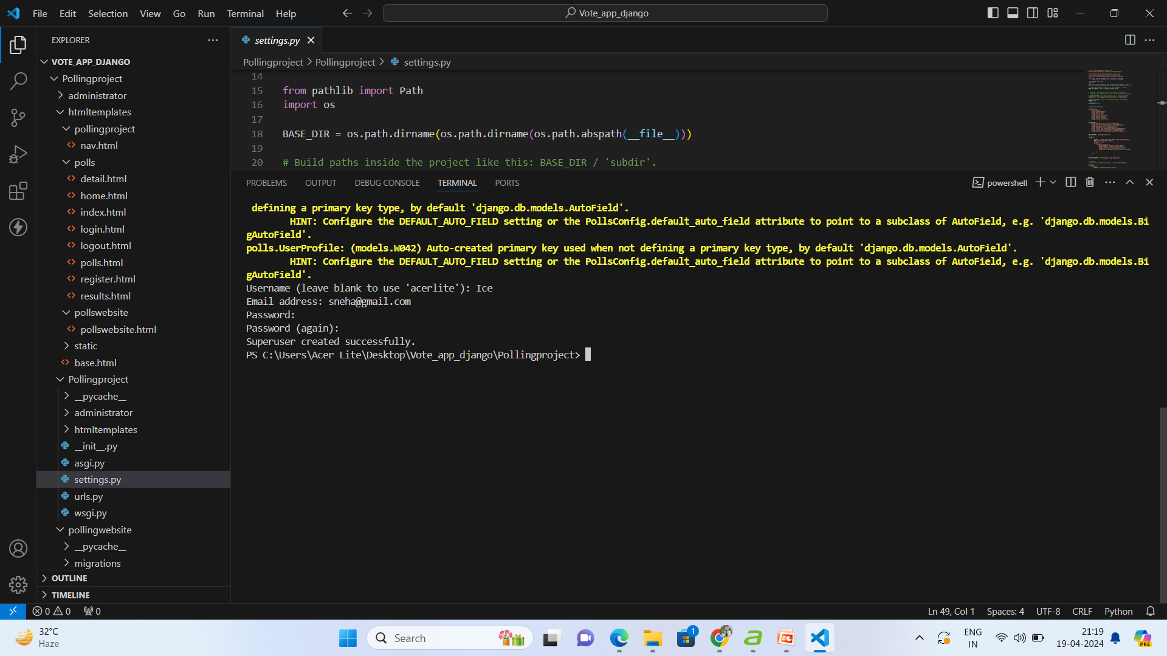
How to run the django project after creation:

Slide 26
CONCLUSION: Here the voting application can be created using the django framework with default sqllite. Hereby, I have developed the navbar , routing, admin panel and the styling of pages etc., The Whole coding part, I have developed can be included in the Voting_app_coding.zip file. The screenshots of the developed project also included in this presentation. The voting application can be developed and executed successfully. Thank you…..

